Slide 1
Brief your board:
Key takeaways from Q4-2024 for Finance and Insurance Directors

Slide 2

How to use this presentation
This presentation is meant to help you as technical expert to brief your management on specific issues of cyber security
We have included background information, key research statistics and expert recommendations to make a convincing and thorough, yet straight to the point business case
We have divided the deck into
  Briefing for you: information you need to know about current/recent relevant events
  Key takeaways and information you can use to present this, how it is relevant to your industry and make the business case
  Practical steps to improve your situation and
  benefit your organization as briefing presentation

Slide 3



Background:
What impacts your vertical: Finance and Insurance

Slide 4
Summary:
What has been impacting Finance & Insurance in Q4 2024?
Orange Cyberdefense CERT recently observed several highly critical vulnerabilities exploited in practice by threat actors
Most of them were related to remote connection technology like VPN or security assets like firewalls
Some state-affiliated activity has been observed too, also exploiting vulnerabilities in remote access tech, as well as sophisticated attacks to steal information from WiFi connections and Phishing
Two out of three incidents have been triggered by an outsider, one has been triggered by an insider (malicious or non malicious, e.g. through unauthorized access or misconfiguration)
Though the finance sector is in the upper middle field in terms of vulnerability handling across the industries we see (score of 8 out of 13), we still see critical vulnerabilities being unpatched for 136 days
Our CyberSOC customers are a bit above the average in responding fast to incidents with a mean time taken for an incident to be resolved of 56 hours (avg: 65 hours)
DORA will have a direct impact on requirements regarding reaction time, procedures, resilience and defensive capabilities for compliance

Slide 5





Security Bulletin:
The most impactful news from our CERT in 2024-Q4
Update 27:
Lazarus aresenal in constant development, new TTPs observed in attacks against FinTech and cryptocurrency providers
Update 6:
Volt Typhoon rebuilds its botnet network as China continues to deny any involvement with the group
Initial:
Orange Cyberdefense CERT releases deep-dive study and interactive map on China‘s cyber civil-military-industry complex
Update 8:
APT28 continues credential harvesting attempts against European targets, tied to sophisticated WiFi hacking technique
W45 (04/11-10/11)
W46 (11/11-17/11)
W47 (18/11-24/11)
W48 (25/11-01/12)
Update 2:
Fix for FortiManager 0-day CVE-2024-47575 bypassed by WatchTowr, but detals/PoC not released publicly
Initial:
Palo Alto reveals an RCE vulnerability in PAN-OS Management Interface without providing a patch
Update 1:
Palo Alto Networks fixes CVE-2024-0012 and CVE-2024-9474, two 0-days in PAN-OS Web Management Interface
Update 2:
Massive compromise of PAN Web Management Interface, TTPs of some attacks revealed
Update 3:
FortiManager flaw CVE-2024-47575 bypassed by WatchTowr, details/PoC published
Update 2:
CVE-2024-38812 and CVE-2024-38813 affecting Vmware vCenter Server exploited in the wild
Financially motivated campaigns
Initial:
Citrix devices affected by vulnerabilities exploitation chain allowing RCE
Initial:
Chinese APT BrazenBamboo exploits an unpatched 0-day in FortiCLient Windows VPN
State-sponsored espionage operations
Newly-discovered or exploited vulnerabilities

Slide 6
1. Vulnerabilities
Updated – FortiManager flaw CVE-2024-47575 bypassed by WatchTowr, details/PoCs are now public
Advisory date: 15/11/2024 | Threat level: 5/5 | CVE: CVE-2024-47575
Follow up to 0-day affecting FortiManager (see October presentation) => new updates due to PoC & Exploit released by WatchTowr.
FortiManager used to manage products by automating security ops.
New issue, known as « FortiJumpHigher » (no CVE) means FortiJumpHigher is considered as a post-authentication privilege escalation attack, instead of the full RCE that is FortiJump.
Exploited since May at least by Chinese group UNC5820.
Citrix devices affected by vulnerabilities exploitation chain allowing RCE
Advisory date: 13/11/2024 | Threat level: 3/5 | CVE: CVE-2024-8068, CVE-2024-8069
Patch released for exploitation of 2 chained vulnerabilities in Citrix Virtual Apps and Desktop.
Leads to RCE by unauthenticated attacker.
WatchTowr published technical details and exploitation code.
Early exploitation attempts implies incoming massive exploitation
Updated – Palo Alto fixes RCE vulnerability in PAN-OS Management Interface
Advisory date: 25/11/2024 | Threat level: 4/5 | CVE: CVE-2024-0012, CVE-2024-9474
RCE in the management interface of Palo Alto firewalls.
Mitigations then official patch released 4 days later. Limited exploitation in the wild first observed (Operation Lunar Peek), before the patch.
Technical details released after the patch led to massive exploitation of instances, including by financially-motivated threat actors.
Notes:
2024 November Microsoft Patch Tuesday: 2 vulnerabilities exploited in the wild
Advisory date: 09/10/2024 | Threat level: 2/5| CVE: CVE-2024-43451, CVE-2024-49039
89 vulnerabilities = 0 0-days, two exploited itw.
CVE-2024-43451: impersonation vulnerability. Once successfully exploited, the attacker can authenticate as a user. Already exploited in the wild but no attribution.
CVE-2024-49039: elevation of privilege vulnerability in the Windows Task Scheduler. Flaw is likely to be massively exploited.

Slide 7




2. Cybercrime Trends
> First stage payloads, IABs and stealers
Other trending campaigns:
PhaaS like Tycoon, Mamba
Venom Spider-related malware
Emmenhtal
To monitor for upcoming weeks:
MintsLoader (return?)
DarkGate (return?)
Banque de France hacked by near2tlg, data sold for $10k (11/24)
Provider for Missions locales, compromised, risk of data leak (10/24)
DroidBot, MaaS targeting Europe, credential theft
FINCEN alert on fraud attempts leveraging AI
Updated - FakeBat distributes again Lumma in SEO poisoning campaigns via Google ads
Advisory date: 03/12/2024 | Threat level: 2/5
Resurgence of FakeBat campaigns in November, after 3 months hiatus after July 2024.
TTPs remain almost identical with malicious ads for popular apps being promoted through SEO poisoning.
Ultimate payload often is Lumma stealer.
Tied to threat actor called APOTHECARY SPIDER.
Updated - GootLoader tests new SEO poisoning technique, tricks users via online PDF conversion websites
Advisory date: 02/12/2024 | Threat level: 3/5
Since November, evolution of GootLoader deliveries. Now uses direct malicious websites providing online PDF converting tools and promoted by SEO poisoning.
Core C2 infrastructure was also moved around September from the Prospero Bulletproof Hosting Provider to another (Proton66). Possibly explained by the fact Google now blacklists more proactively GootLoader infected pages.
Regularly seen throughout 2024 in pre-ransomware activities: INC, BlackSuit, Rhysida.
Tied to threat actor called Storm-0494.

Slide 8

2. Cybercrime Trends
> Ransomware trends
Trending Cy-X operations:
RansomHub: 98
Akira: 72
Kill Security: 41
SAFEPAY: 32
Qilin: 28
November 2024
Total of 616 incidents.
KillSec hacktivist Ransomware-as-a-Service operation targets organizations worldwide
Advisory date: 03/12/2024 | Threat level: 2/5
Clear increase of victim claims from KillSec in November.
Double extortion operation first identified around October 2023.
Tied to hacktivist cluster (active since 2021) which shifted towards Ransowmare as a Service.
Encryptor provided for $250 to affiliates + 12% commission on ransomware payments. Relies on a Telegram channel + leak site.
KillSec is allegedly also developing:
Distributed Denial-of-Service (DDoS) services,
a bespoke information stealer malware family,
a Vishing-as-a-Service (VaaS) program.
Départment of Réunion => Termite (11/24)
Leaks de Free, Mediboard, Le Point, Auchan, Direct Assurance, Banque de France, SFR et Norauto.
KillSec claimed victims in 2024

Slide 9


3. APT Trends
Salt Typhoon targeted Trump and other political figures
Data belonging to Dutch police stolen by malicious actors (09/24)
Private investigations company Equalize hacked Italian politicians and government databases
Chinese APT deployed SharpSQLTools against a UAE-based financial entity.
Ukrainian intelligence targeted Gazprombank with a DDoS attack
China
Trending targeted sectors: government, telecommunication, energy
BrazenBamboo exploits an unpatched 0-day in FortiClient Windows VPN. Campaign involves malware dubbed DEEPDATA, designed to collect and exfiltrate sensitive information from compromised systems. Victimology remains unknown.
Earth Kasha targets Japanese organizations using NOOPDOOR and ANEL malware. Associated to APT10 umbrella.
Earth Estries targets telco companies in Southeast Asia with new GhostSpider backdoor.
Gelsemium targets Linux systems in Southeast Asia with WolfsBane malware.
Russia
Trending targeted sectors: government, think-tanks
APT28 continues credential harvesting attempts against European targets: Ukraine, Poland, Germany.
Typical TTPs: sophisticated spear phishing , known malware such as the Headlace backdoor, living-off-the-land binaries and legitimate Internet services (including Mocky, InfinityFree, Mockbin or GitHub).
Also recently tied to sophisticated Wi-Fi hacking technique, dubbed “Nearest Neighbor Attack“. Daisy-chaining of at least three networks belonging to different organizations located in or near the same building, to reach their final target.

Slide 10

4. Hacktivism Trends
Government of Luxembourg targeted by DDoS (10/24)
German office of statistics Destatis compromised indonesian hacktivists (11/24)
French government orgs and cities targeted by DDoSIA
Russian Cyber Army targeted the Italian Association of Financial Intermediaries
Deutsche Bundesbank targeted during #OpGermany
Updated - U.S. justice indicted Anonymous Sudan operators, effectively halting the group's activities
Advisory date: 17/10/2024 | Threat level: 0/5
US law enforcement arrested two Sudanese brothers in an undisclosed country in March.
One of them faces life-time in prison for the attack against Los Angeles hospital.
Infrastructure seized in March and attacks stopped, indicating that the group is down.
Law enforcement target hacktivists after cybercriminals, consequences on the ecosystem?
Updated - NoName057(16) continues its pro-Russian DDoS attacks all around the world, including in Europe
Advisory date: 22/10/2024 | Threat level: 2/5
Massive campaigns in October against Belgium, Czech Republic, Austria, Ukraine, Canada, as well as Taiwan and Japan.
Victims often chosen in reaction to political news => support for Ukraine.
Often operate alongside other pro-Russian groups such as CyberDragon, Shapito666, CyberVolk.
Latest attacks against the United Kingdom.

Slide 11

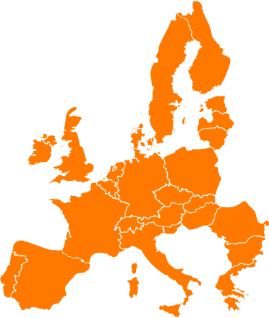
Regulation brief: DORA
What is DORA?
DORA is a sector-specific directive for financial institutions, targeting their approach to operational risk. It introduces rules for managing all aspects of operational resilience, particularly emphasizing protection, detection, containment, recovery, and repair capabilities against ICT-related incidents.
Compliance deadline:
January 2025
What it means for your business
You’ll need to develop digital operational resilience.
Actions required:
Establish a sound, comprehensive and a well-documented information and communication technologies (ICT) risk management framework.
Implement an ICT incident management process to detect, manage, classify, and notify incidents.
Manage and monitor risks related to ICT third-party service providers.
Establish a sound and comprehensive digital operational resilience testing program.
Who is impacted?
Financial entities and ICT service providers within the European Union (EU)., including:
Traditional financial institutions
Emerging financial entities
Critical third-party service providers
Here’s why it matters
DORA fosters a cyber-resilient ecosystem, safeguarding critical functions and customer trust. While NIS2 is a directive that allows countries to develop rules based on their specific national needs, DORA is a regulation, leaving no room for discretion at the Member State level.

Slide 12

Background-info:
How Finance & Insurance compares to other industries
In Finance and Insurance, Cy-X incident volumes have declined by 27%, but we still recorded 196 victims this year, with a concentration in Credit Intermediation and Securities.
External actors are responsible for most reported CyberSOC incidents, primarily targeting servers and accounts. We report a high proportion of hacking and social engineering incidents, which is unusual to this section.
The sector’s CSOC metrics show the highest coverage score at 55.87% and an MTTR of 56 hours, with a true positive ratio of 8.3%.
VOC metrics reveal a low findings-per-asset rate at 10.03, though critical vulnerabilities may persist unresolved for an average of 136 days.

Slide 13
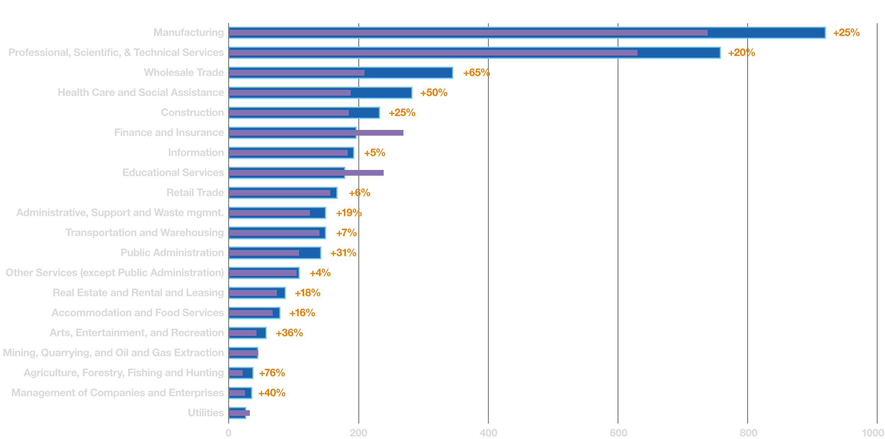
Cy-X: Shifts in Industry Victims
Change in Victim Count In Different Industries yoy.
2023
2024

Slide 14
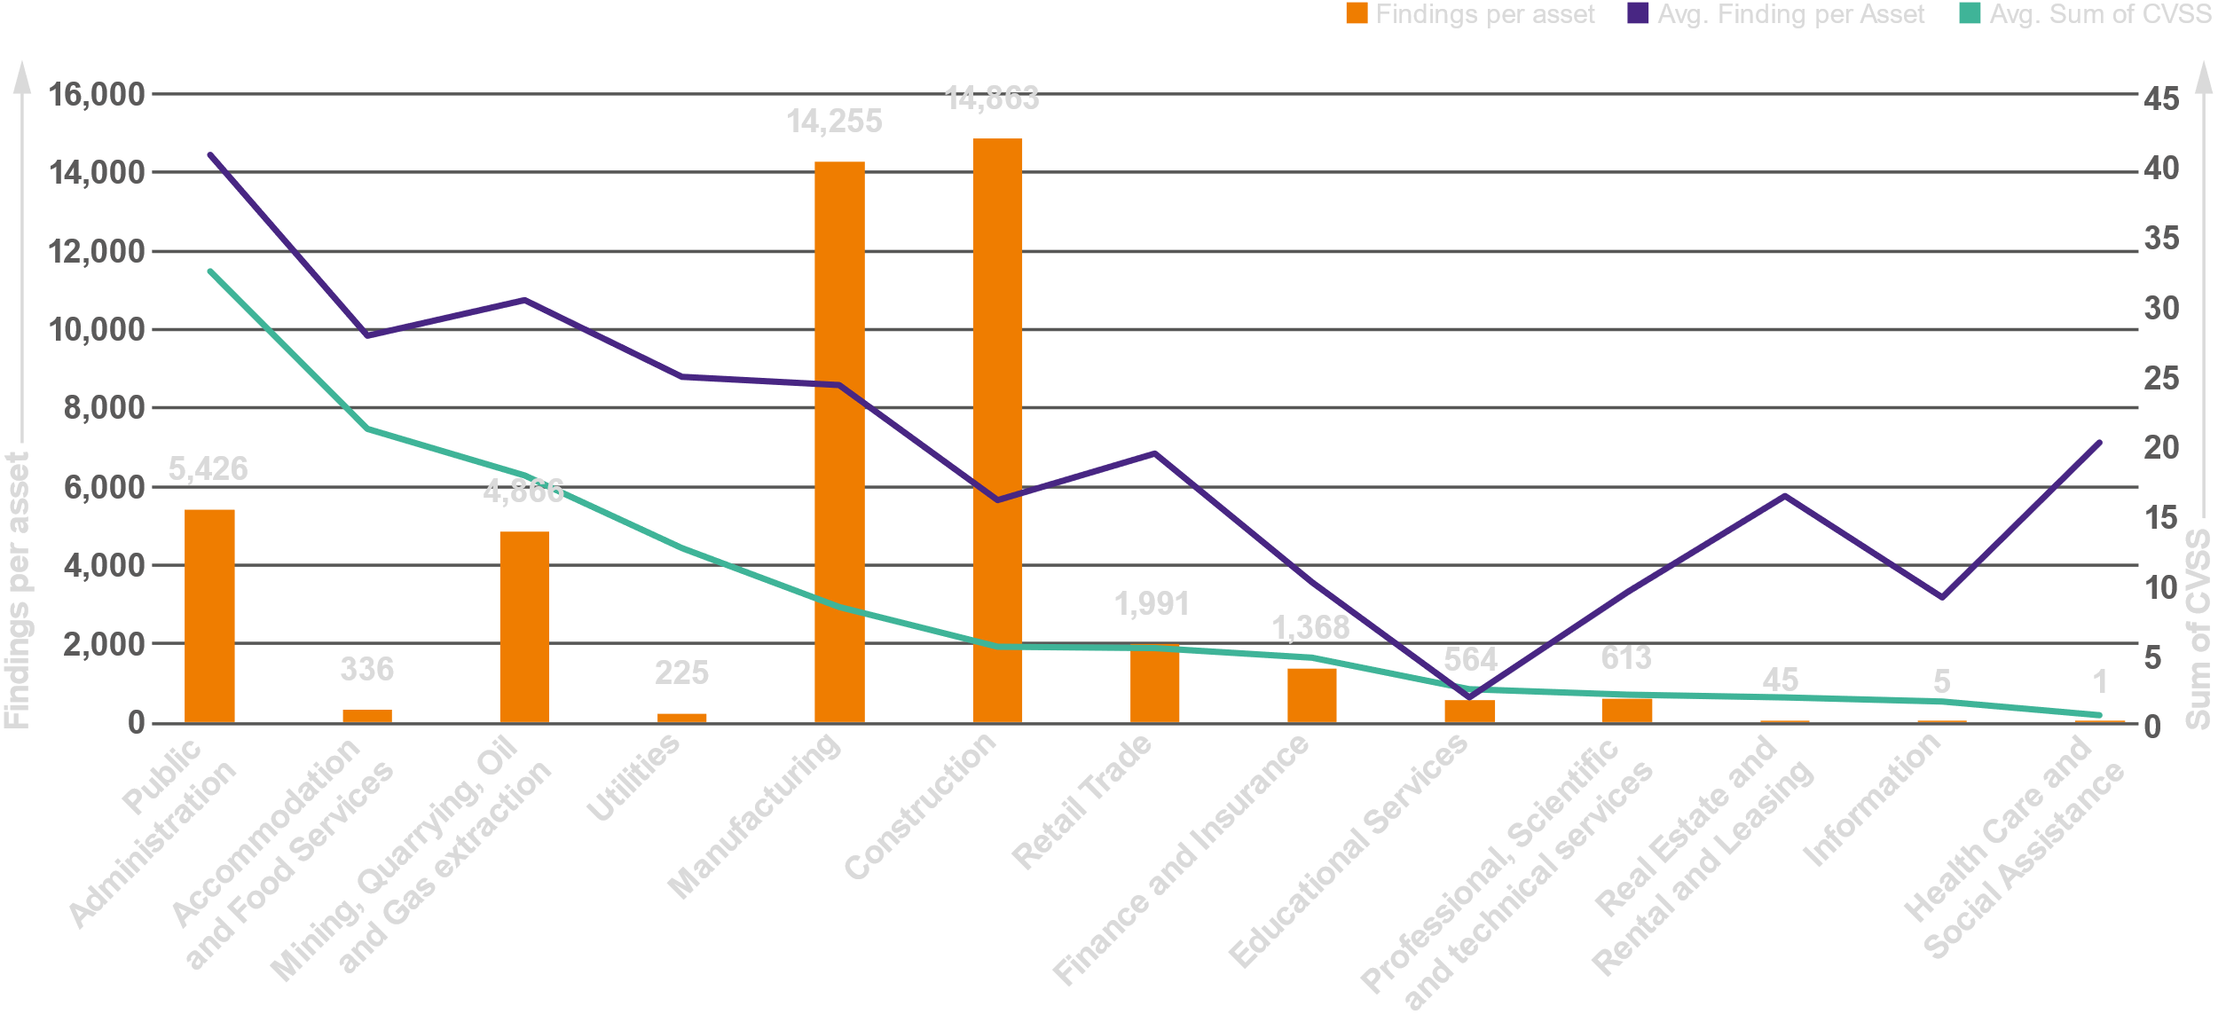
VOC: Findings per Asset by Industry
Average Unique Findings per Unique Asset

Slide 15
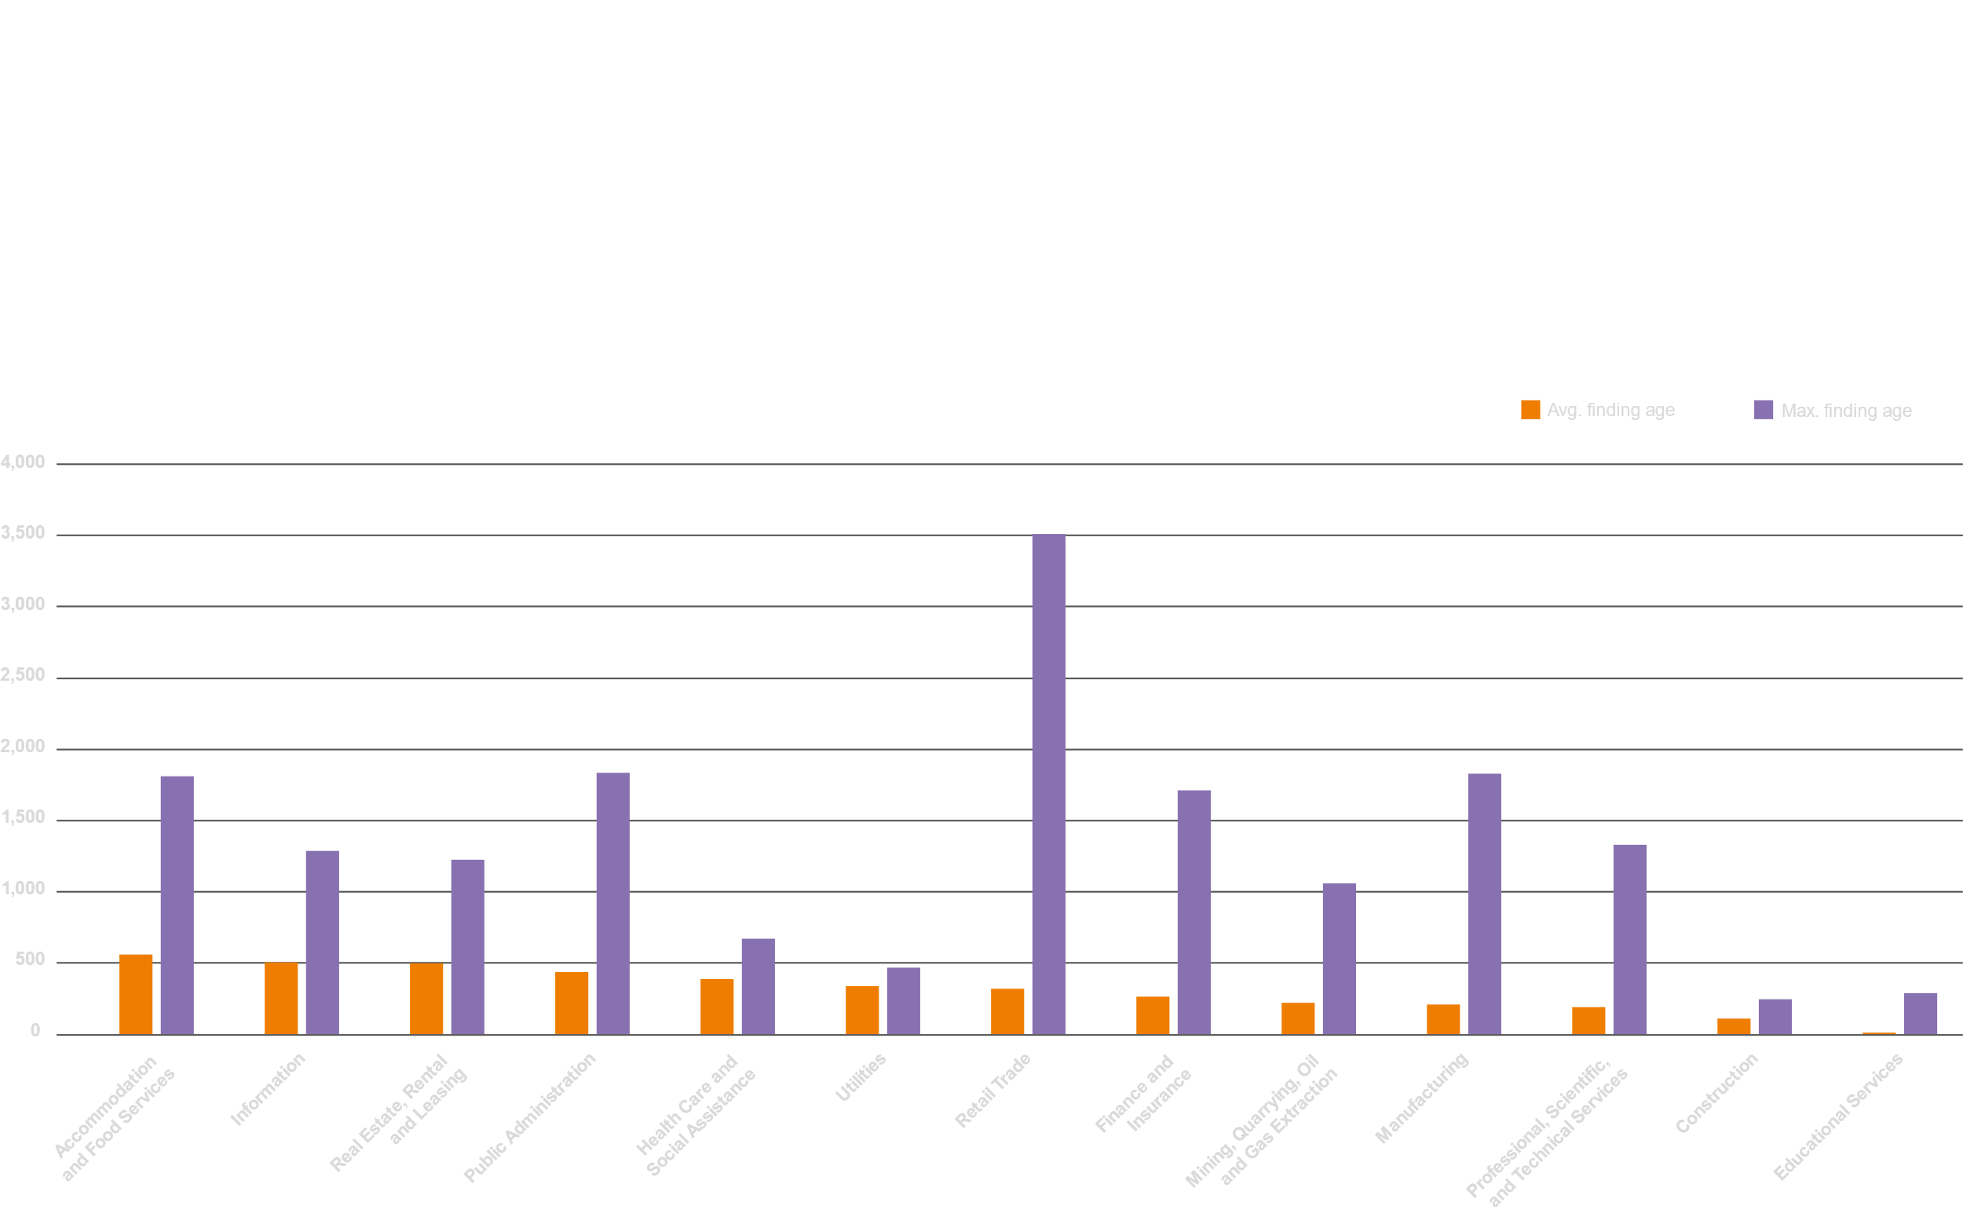
VOC: Age of Vulnerability Findings by Industry
Average and Max. Age of Unique Findings for Different Verticals in Days (Ordered by Average)

Slide 16
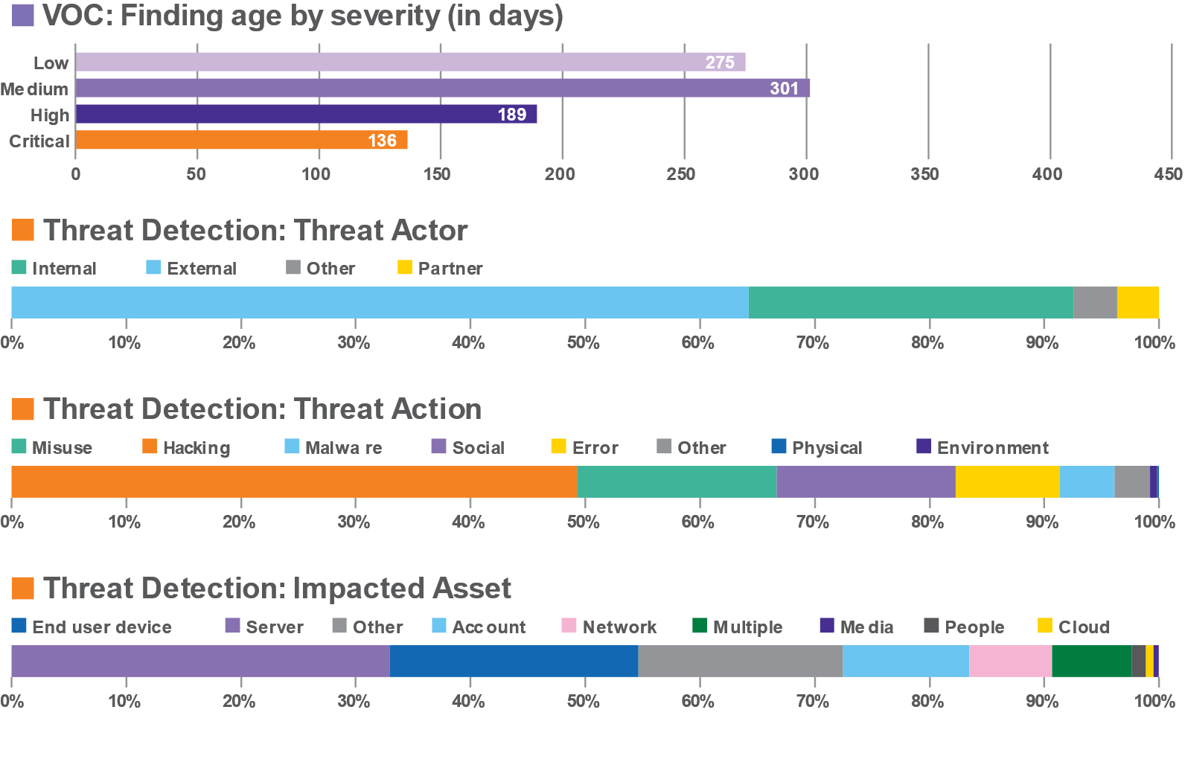

Finance and Insurance

Slide 17
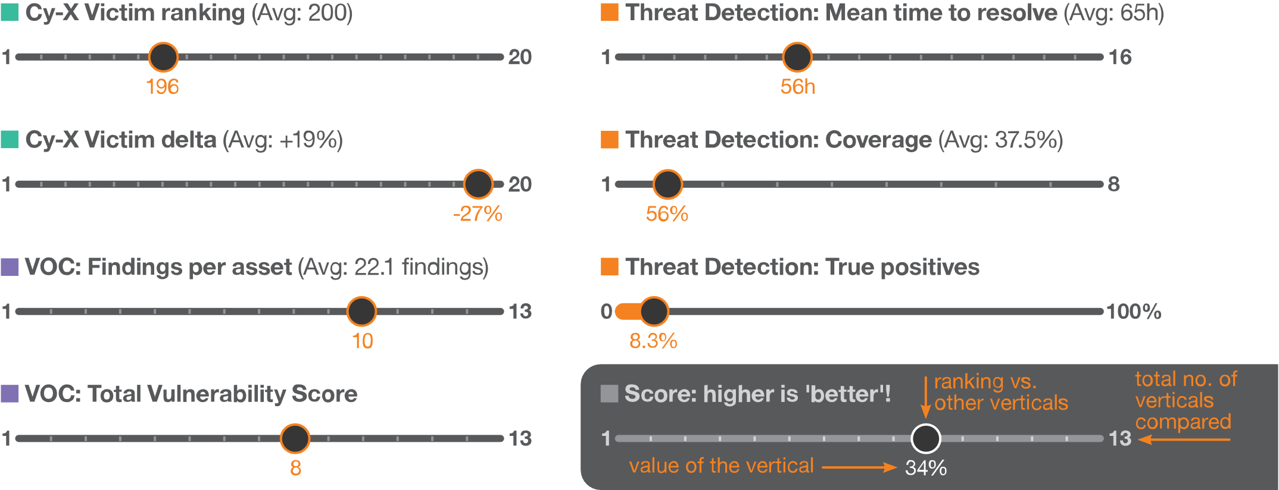
Finance and Insurance

Slide 18
Takeaways for CISO/CIO

Slide 19
Three critical ways in which this affects the Finance industry:
1
2
3
Traditional remote access technology like VPN is challenged very frequently. Investment into more modern concepts can reduce risk significantly.
This increases potential damage and financial loss in case of a serious attack.
Finance is a target for high-profile, state-affiliated actors, using advanced techniques and potentially have motivations beyond just financial gain. Countering state affiliated APT groups requires advanced detection and threat hunting operations.
Patch Management is a challenge, but also a vital lever to improve the situation. Critical vulnerabilities remaining open for over 136 days give attackers an extensive window of opportunity to cause damage

Slide 20
1: Replace VPN with SASE and Zero Trust
Problem: We frequently see vulnerabilties in VPN solutions like Citrix, Fortinet and Ivanti being exploited at large scales. Several new vulnerabilities are actively being exploited at this point.
Solution: Implement a Secure Access Service Edge (SASE) architecture, which enables secure communication and access to company resources while enforcing strong security authentication to make sure noone who is not authorized has access. This approach combines networking with a security component, replacing two separate solutions with a unified one, that is significantly more robust, secure and efficient.
Benefits:
  Reduce complexity by integrating two technologies into one approach, delivered by one provider
  Significantly reduce risk
  Ensure reliable, auditable compliance at all times
Notes:
Vulnerabilities in VPN can invalidate all other security and when breached can lead to rapid compromise (in a matter of hours)!
Alternatives: Either keep patching (increased spending over time the older the tech gets) or move to investing into a new approach or setup.

Slide 21
2: Advanced threat hunting: prevent, prepare, contain
Problem: Finance is a target for state-affiliated, politically motivated actors with extensive resources. Their sophistication makes them dangerous. Stopping these groups requires advanced detection and threat hunting.
Solution: Managed Detection and Response services (MDR) with included Threat Hunting can detect and stop even advanced threat actors. Outsourcing this to a trusted partner with a reputable background in Threat Intelligence allows efficient safeguarding of vital digital assets and IP, as well as early, proactive protection from information theft or intentional damage campaigns.
Benefits:
  No elongated, expensive hunting for talent that is scarce on the market
  Plannable costs as opposed to maintaining, training and equiping an internal team
  Freeing up resources in the IT team, as only confirmed incidents are escalated and hunting is done by experienced professionals
  Vital intelligence and research are included and don‘t have to be collected and financed internally

Slide 22
3: Manage vulnerabilities: VOC scanning, priority based patching
Problem: Vulnerability and Patch Management is constant challenge. Critical vulnerabilities remaining open for too long give attackers an extensive window of opportunity to cause damage. Patching everything constantly consumes extensive IT resources (in May 2024, 164 vulnerabilities were published by MITRE per day!)
Solution: Instead of attempting to keep track with an exploding number of vulnerabilities, it makes sense to patch intelligently, prioritizing by factors like
  the importance of assets/resources for maintaining your business operational
  the severity with which these assets could be impacted
  the threat situation: is a vulnerability actively used in attacks?
While points one and two above could be done in-house, the third aspect – the crucial intelligence part – can only be obtained from a professional service provider.
Automated vulnerability scanning services, backed with intelligence insights and awareness of the organization‘s unique situation offer a way out of the vulnerability treadmill and help to regain control
Benefits:
  Clear priorities help to maintain a high standard of security and keep operations up
  Resources are spent efficiently instead of wasting time patching low priority assets for vulnerabilities
  that are not even exploited by threat actors

Slide 23

Briefing:
Better Patch Management
Finance & Insurance

Slide 24
Security Bulletin:
What has been impacting Finance & Insurance in Q4 2024?
Vulnerabilities
In legacy Network technology
State-backed actors
Criminals seeking financial gain
What to do about this?

Slide 25

1: Consider your VPN strategy
Problem:
Relying on VPN solutions like Citrix, Fortinet and Ivanti becomes a security- and business risk.
Solutions:
  Upgrading the security of VPN technology can mitigate some of the problems at hand for the time beeing. Unplanned follow up investment may be required if new issues arise.
  Solutions that help IT to react faster to vulnerability can help. This investment will need to be scaled up, as vulnerabilities become more frequent
  A more future-proof investment is a change in architecture to combine networking and connection security, replacing two separate solutions with a unified one, that is significantly more robust, secure and cost efficient
  Benefits:
      Reduce complexity by a unified approach, delivered by one provider
      Significantly reduce risk
      Ensure reliable, auditable compliance at all times
Notes:
Vulnerabilities in VPN can invalidate all other security and when breached can lead to rapid compromise (in a matter of hours)!
Alternatives: Either keep patching (increased spending over time the older the tech gets) or move to investing into a new approach or setup.

Slide 26

2: Advanced Threat hunting: prevent, prepare, contain
Problem:
State-affiliated/politically motivated actors have extensive resources and persue disruption or espionage rather than financial motivations. Safeguarding of business-critial digital assets and IP, as well as early, proactive protection from information theft or intentional damage campaigns requires expert knowledge.
Solutions:
  The risk can be accepted, preparing for managing incidents in case of severe disruption attacks
  A sophisticated, in-house security team with advanced detection capabilities can be built up. Requires investments in HR to hunt talent. Equipment and facilities need to be set up.
  Detection can be outsourced to a service provider.
  Benefits:
      Plannable costs as opposed to maintaining, training and equiping an internal team
      Freeing up resources in the IT team
      Vital intelligence and research are included and don‘t have to be purchased separately

Slide 27

3: Manage vulnerabilities better
Problem:
Vulnerability and Patch Management consumes extensive IT resources (tendency: software vulnerabilities have grown in number +14% to +24% YoY in the past five years)
Solutions:
  Invest in additional layers of security for the most vulnerable technologies. Professional consulting can help to efficiently spend the budget for best risk reduction.
  Invest in IT resources to frequently check published vulnerabilities. IT needs to assess, test and implement patches as they are published and research workarounds, in case patches don‘t exist. This investment will need to scale according to the growth in vulnerability number.
  Automated vulnerability scanning services with threat intelligence offer a way to regain control. This considers the importance of assets/resources, the severity of potential impact and the threat situation: is a vulnerability actively used in attacks?
  Benefits:
      Clear priorities keep your vital assets safe and business operational
      No wasting of resources in patching low priority assets for vulnerabilities that are not exploited
      No cost explosion

